Slide 1
Declaration and Access Modifiers
I WANNA HAVE A CUP OF JAVA

Slide 2
Agenda
1. Java source file structure
o Import statement
o Types of Import Statements
▪ Explicit class import
▪ Implicit class import
o Difference between C language #include and java language import ?
o 1.5 versions new features
o Static import
▪ Without static import
▪ With static import
o Explain about System.out.println statement ?
o What is the difference between general import and static import ?
o Package statement
▪ How to compile package Program
▪ How to execute package Program
o Java source file structure
2. Class Modifiers
o Only applicable modifiers for Top Level classes
o What is the difference between access specifier and access modifier ?
o Public Classes
o Default Classes
o Final Modifier
▪ Final Methods
▪ Final Class
o Abstract Modifier
▪ Abstract Methods
▪ Abstract class
o The following are the various illegal combinations for methods
o What is the difference between abstract class and abstract method ?
o What is the difference between final and abstract ?
o Strictfp
o What is the difference between abstract and strictfp ?

Slide 3
3. Member modifiers
o Public members
o Default member
o Private members
o Protected members
o Compression of private, default, protected and public
o Final variables
▪ Final instance variables
▪ At the time of declaration
▪ Inside instance block
▪ Inside constructor
▪ Final static variables
▪ At the time of declaration
▪ Inside static block
▪ Final local variables
o Formal parameters
o Static modifier
o Native modifier
▪ Pseudo code
o Synchronized
o Transient modifier
o Volatile modifier
o Summary of modifier
4. Interfaces
o Interface declarations and implementations
o Extends vs implements
o Interface methods
o Interface variables
o Interface naming conflicts
▪ Method naming conflicts
▪ Variable naming conflicts
o Marker interface
o Adapter class
o Interface vs abstract class vs concrete class
o Difference between interface and abstract class?
o Conclusions

Slide 4
Java source file structure

Slide 5
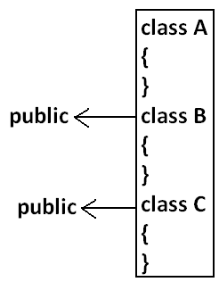
2
4
116
• A java Program can contain any no. Of classes but at most one class can be
declared as public. "If there is a public class the name of the Program and name
of the public class must be matched otherwise we will get compile time error".
• If there is no public class then any name we gives for java source file.
Case 1:
If there is no public class then we can use any name for java source file there are no
restrictions.
case 2:
If class B declared as public then the name of the Program should be B.java otherwise
we will get compile time error saying "class B is public, should be declared in a file
named B.java".
Example:
A.java
B.java
C.java
Ashok.java

Slide 6
Case 3:
• If both B and C classes are declared as public and name of the file is B.java then
we will get compile time error saying "class C is public, should be declared in a
file named C.java".
• It is highly recommended to take only one class for source file and name of the
Program (file) must be same as class name. This approach improves readability
and understandability of the code.
class B
{
public static void main(String args[]){
System.out.println("B class main method is executed");
}
}
class C
{
public static void main(String args[]){
System.out.println("C class main method is executed");
}
}
class D
{
}
Example:
class A
{
public static void main(String args[]){
System.out.println("A class main method is executed");
}
}
117

Slide 7
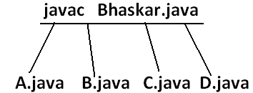
Output:
D:\Java>java A
A class main method is executed
D:\Java>java B
B class main method is executed
D:\Java>java C
C class main method is executed
D:\Java>java D
Exception in thread "main" java.lang.NoSuchMethodError: main
D:\Java>java Ashok
Exception in thread "main" java.lang.NoClassDefFoundError: Ashok
118

Slide 8
• We can compile a java Program but not java class in that Program for every
class one dot class file will be created.
• We can run a java class but not java source file whenever we are trying to run a
class the corresponding class main method will be executed.
• If the class won't contain main method then we will get runtime exception saying
"NoSuchMethodError: main".
• If we are trying to execute a java class and if the corresponding .class file is not
available then we will get runtime execution saying "NoClassDefFoundError:
Ashok".

Slide 9
Import statement

Slide 10
class Test{
public static void main(String args[]){
ArrayList l=new ArrayList();
}
}
Output:
Compile time error.
D:\Java>javac Test.java
Test.java:3: cannot find symbol
symbol : class ArrayList
location: class Test
ArrayList l=new ArrayList();
Example:
import java.util.ArrayList;
class Test{
public static void main(String args[]){
ArrayList l=new ArrayList();
}
}
Output:
D:\Java>javac Test.java
• We can resolve this problem by using fully qualified name
"java.util.ArrayList
l=new java.util.ArrayList();". But problem with using fully qualified name every
time is it increases length of the code and reduces readability.
• We can resolve this problem by using import statements.
Hence whenever we are using import statement it is not require to use fully qualified
names we can use short names directly. This approach decreases length of the code and
improves readability.
118

Slide 11
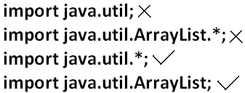
Case 2:
Which of the following import statements are meaningful ?
• The code compiles fine even though we are not using import statements because
we used fully qualified name.
• Whenever we are using fully qualified name it is not required to use import
statement. Similarly whenever we are using import statements it is not require to
use fully qualified name.
Case 4:
Example:
import java.util.*;
import java.sql.*;
class Test
{
public static void main(String args[])
{
Date d=new Date();
}}
Output:
Compile time error.
D:\Java>javac Test.java
Test.java:7: reference to Date is ambiguous,
both class java.sql.Date in java.sql and
class java.util.Date in java.util match
Case 3:
consider the following code.
class MyArrayList extends java.util.ArrayList
{
}
120

Slide 12
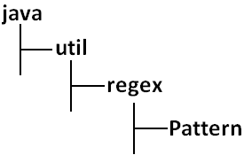
Date d=new Date();
Note: Even in the List case also we may get the same ambiguity problem because it is
available in both util and awt packages.
Case 6:
Whenever we are importing a package all classes and interfaces present in that package
are by default available but not sub package classes.
Case 5:
While resolving class names compiler will always gives the importance in the following
order.
1. Explicit class import
2. Classes present in current working directory.
3. Implicit class import.
Example:
Example:
import java.util.Date;
import java.sql.*;
class Test
{
public static void main(String args[]){
Date d=new Date();
}}
To use pattern class in our Program directly which import statement is required ?
The code compiles fine and in this case util package Date will be considered.
120

Slide 13
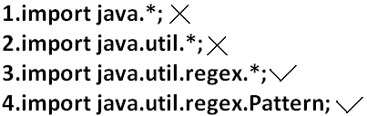
To use pattern class in our Program directly which import statement is required ?
Difference between C language #include and java language import ?
#include | import
It can be used in C & C++ | It can be used in Java
At compile time only compiler copy the code from standard library and placed in current program. | At runtime JVM will execute the corresponding standard library and use it's result in current program.
It is static inclusion | It is dynamic inclusion
wastage of memory | No wastage of memory
Ex : <jsp:@ file=""> | Ex : <jsp:include >
Case7:
In any java Program the following 2 packages are not require to import because these
are available by default to every java Program.
1. java.lang package
2. default package(current working directory)
Case 8:
"Import statement is totally compile time concept" if more no of imports are there then
more will be the compile time but there is "no change in execution time".
122

Slide 14
• In the case of C language #include all the header files will be loaded at the time
of include statement hence it follows static loading.
• But in java import statement no ".class" will be loaded at the time of import
statements in the next lines of the code whenever we are using a particular class
then only corresponding ".class" file will be loaded. Hence it follows "dynamic
loading" or "load-on -demand" or "load-on-fly".

Slide 15
1.5 versions new features
1. For-Each
2. Var-arg
3. Queue
4. Generics
5. Auto boxing and Auto unboxing
6. Co-varient return types
7. Annotations
8. Enum
9. Static import
10. String builder

Slide 16
Without static import:
class Test
{
public static void main(String args[]){
System.out.println(Math.sqrt(4));
System.out.println(Math.max(10,20));
System.out.println(Math.random());
}}
Output:
D:\Java>javac Test.java
D:\Java>java Test
2.0
20
0.841306154315576
123

Slide 17
With static import
import static java.lang.Math.sqrt;
import static java.lang.Math.*;
class Test
{
public static void main(String args[]){
System.out.println(sqrt(4));
System.out.println(max(10,20));
System.out.println(random());
}}
Output:
D:\Java>javac Test.java
D:\Java>java Test
2.0
20
0.4302853847363891
123

Slide 18
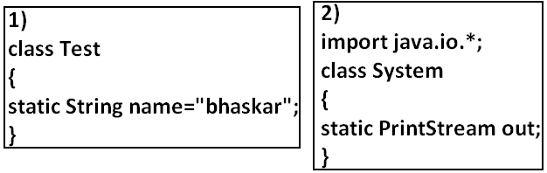
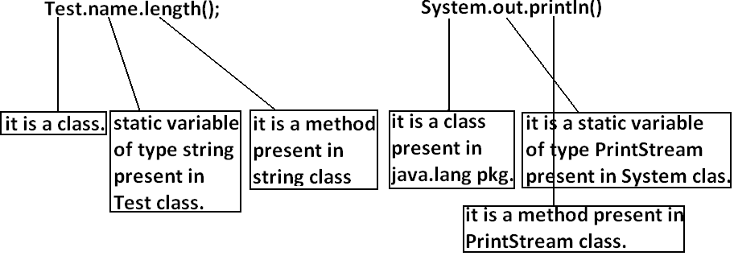
Explain about System.out.println statement ?
124

Slide 19
Example 3:
import static java.lang.System.out;
class Test
{
public static void main(String args[]){
out.println("hello");
out.println("hi");
}}
Output:
D:\Java>javac Test.java
D:\Java>java Test
hello
hi
Output:
Compile time error.
D:\Java>javac Test.java
Test.java:6: reference to MAX_VALUE is ambiguous,
both variable MAX_VALUE in java.lang.Integer and variable MAX_VALUE in
java.lang.Byte match
System.out.println(MAX_VALUE);
Note: Two packages contain a class or interface with the same is very rare hence
ambiguity problem is very rare in normal import.
But 2 classes or interfaces can contain a method or variable with the same name is very
common hence ambiguity problem is also very common in static import.
Example 4:
import static java.lang.Integer.*;
import static java.lang.Byte.*;
class Test
{
public static void main(String args[]){
System.out.println(MAX_VALUE);
}}
124

Slide 20
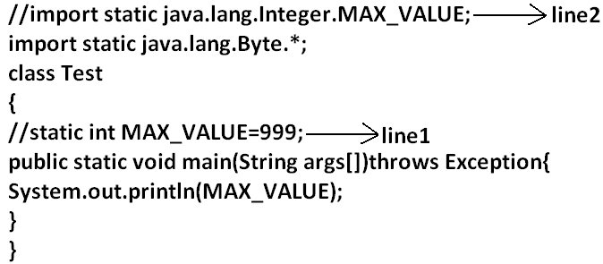
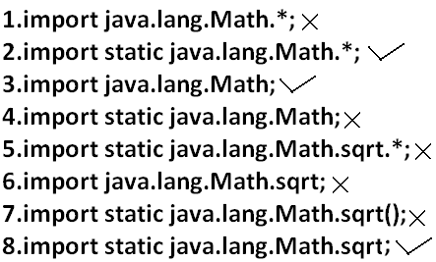
• If we comet line one then we will get Integer class MAX_VALUE 2147483647.
• If we comet lines one and two then Byte class MAX_VALUE will be considered
127.
While resolving static members compiler will give the precedence in the following order.
1. Current class static members
2. Explicit static import
3. implict static import.
Which of the following import statements are valid ?
125

Slide 21
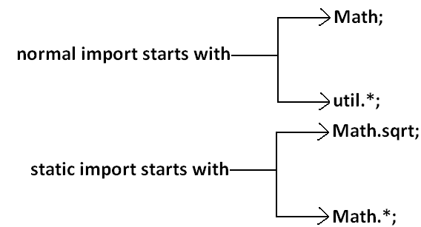
Diagram:
What is the difference between general import and static import ?
• We can use normal imports to import classes and interfaces of a package.
whenever we are using normal import we can access class and interfaces directly
by their short name it is not require to use fully qualified names.
• We can use static import to import static members of a particular class.
whenever we are using static import it is not require to use class name we can
access static members directly.
Usage of static import reduces readability and creates confusion hence if there is no specific requirement never recommended to use static import.
126

Slide 22
Package statement

Slide 23
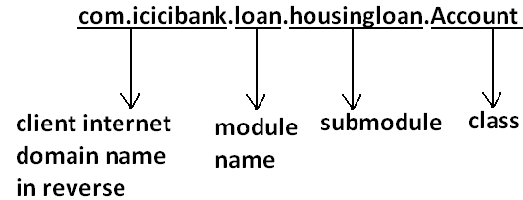
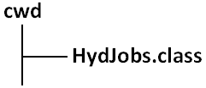
It is an encapsulation mechanism to group related classes and interfaces into a single module.
How to compile package Program:
Example:
package com.durgajobs.itjobs;
class HydJobs
{
public static void main(String args[]){
System.out.println("package demo");
}
}
Javac HydJobs.java generated class file will be placed in current working directory.
The main objectives of packages are:
• To resolve name confects.
• To improve modularity of the application.
• To provide security.
• There is one universally accepted naming conversion for packages that is to use
internet domain name in reverse.
127

Slide 24
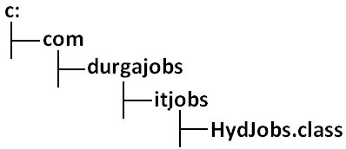
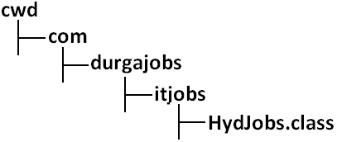
• Javac -d . HydJobs.java
• -d means destination to place generated class files "." means current working
directory.
• Generated class file will be placed into corresponding package structure.
Example:
D:\Java>javac -d c: HydJobs.java
If the specified destination is not available then we will get compile time error.
• If the specified package structure is not already available then this command
itself will create the required package structure.
• As the destination we can use any valid directory.
• If the specified destination is not available then we will get compile time error
Example:
D:\Java>javac -d z: HydJobs.java
If Z: is not available then we will get compile time error
128

Slide 25
Conclusion 2:
In any java Program the 1st non comment statement should be package statement [if it
is available] otherwise we will get compile time error.
How to execute package Program:
D:\Java>java com.durgajobs.itjobs.HydJobs
At the time of execution compulsory we should provide fully qualified name.
Conclusion 1:
In any java Program there should be at most one package statement that is if we are
taking more than one package statement we will get compile time error.
Example:
import java.util.*;
package pack1;
class A
{
}
Output:
Compile time error.
D:\Java>javac A.java
A.java:2: class, interface, or enum expected
package pack1;
Example:
package pack1;
package pack2;
class A
{
}
Output:
Compile time error.
D:\Java>javac A.java
A.java:2: class, interface, or enum expected
package pack2;
129

Slide 26
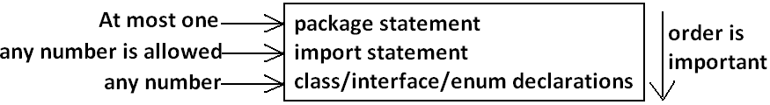
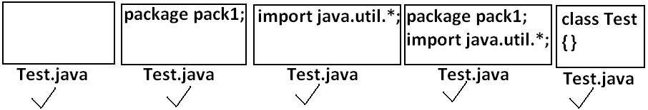
Java source file structure
Note: An empty source file is a valid java Program.
All the following are valid java Programs
130

Slide 27
Class Modifiers

Slide 28
Whenever we are writing our own classes compulsory we have to provide some
information about our class to the jvm.
Like
1. Whether this class can be accessible from anywhere or not.
2. Whether child class creation is possible or not.
3. Whether object creation is possible or not etc.
We can specify this information by using the corresponding modifiers.
If we are using any other modifier we will get compile time error.
Example:
private class Test
{
public static void main(String args[]){
int i=0;
for(int j=0;j<3;j++)
{
i=i+j;
}
System.out.println(i);
}}
OUTPUT:
Compile time error.
D:\Java>javac Test.java
Test.java:1: modifier private not allowed here
private class Test
The only applicable modifiers for Top Level classes are:
1. Public
2. Default
3. Final
4. Abstract
5. Strictfp
130

Slide 29
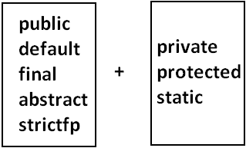
But For the inner classes the following modifiers are allowed.
What is the difference between access specifier and access modifier ?
• In old languages 'C' (or) 'C++' public, private, protected, default are considered
as access specifiers and all the remaining are considered as access modifiers.
• But in java there is no such type of division all are considered as access
modifiers.
131

Slide 30
Public Classes

Slide 31
If a class declared as public then we can access that class from anywhere. With in the
package or outside the package.
Example:
Program1:
package pack1;
public class Test
{
public void methodOne(){
System.out.println("test class methodone is executed");
}}
Compile the above Program:
D:\Java>javac -d . Test.java
Program2:
package pack2;
import pack1.Test;
class Test1
{
public static void main(String args[]){
Test t=new Test();
t.methodOne();
}}
OUTPUT:
D:\Java>javac -d . Test1.java
D:\Java>java pack2.Test1
Test class methodone is executed.
If class Test is not public then while compiling Test1 class we will get compile time error
saying pack1.Test is not public in pack1; cannot be accessed from outside package
131

Slide 32
Default Classes

Slide 33
If a class declared as the default then we can access that class only within the current package hence default access is also known as "package level access".
public static void main(String args[]){
Test t=new Test();
t.methodOne();
}}
OUTPUT:
D:\Java>javac -d . Test.java
D:\Java>javac -d . Test1.java
D:\Java>java pack1.Test1
Test class methodone is executed
Example:
Program 1:
package pack1;
class Test
{
public void methodOne(){
System.out.println("test class methodone is executed");
}}
Program 2:
package pack1;
import pack1.Test;
class Test1
{
132

Slide 34
Final Modifier:
Final is the modifier applicable for classes, methods and variables.

Slide 35
Final Methods

Slide 36
Program 2:
class child extends Parent
{
public void marriage(){
System.out.println("Thamanna");
}}
OUTPUT:
Compile time error.
D:\Java>javac Parent.java
D:\Java>javac child.java
child.java:3: marriage() in child cannot override marriage() in Parent;
overridden method is final
public void marriage(){
• Whatever the methods parent has by default available to the child.
• If the child is not allowed to override any method, that method we have to
declare with final in parent class. That is final methods cannot overridden.
Example:
Program 1:
class Parent
{
public void property(){
System.out.println("cash+gold+land");
}
public final void marriage(){
System.out.println("subbalakshmi");
}}
133

Slide 37
Final Class

Slide 38
Note: Every method present inside a final class is always final by default whether we are
declaring or not. But every variable present inside a final class need not be final.
If a class declared as the final then we cann't creates the child class that is inheritance
concept is not applicable for final classes.
Example:
Program 1:
final class Parent
{
}
Program 2:
class child extends Parent
{
}
OUTPUT:
Compile time error.
D:\Java>javac Parent.java
D:\Java>javac child.java
child.java:1: cannot inherit from final Parent
class child extends Parent
Example:
final class parent
{
static int x=10;
static
{
x=999;
}}
The main advantage of final keyword is we can achieve security.
Whereas the main disadvantage is we are missing the key benefits of oops:
polymorsim (because of final methods), inheritance (because of final classes) hence if
there is no specific requirement never recommended to use final keyboard.
133

Slide 39
Abstract Modifier
Abstract is the modifier applicable only for methods and classes but not for variables
134

Slide 40
Abstract Methods
134

Slide 41
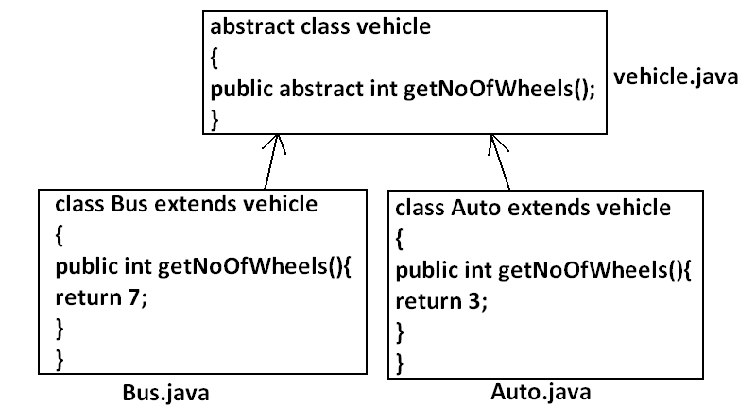
Even though we don't have implementation still we can declare a method with abstract modifier.
That is abstract methods have only declaration but not implementation.
Hence abstract method declaration should compulsory ends with semicolon
Program:
Child classes are responsible to provide implementation for parent class abstract
methods.
• The main advantage of abstract methods is , by declaring abstract method in
parent class we can provide guide lines to the child class such that which
methods they should compulsory implement.
• Abstract method never talks about implementation whereas if any modifier talks
about implementation then the modifier will be enemy to abstract and that is
always illegal combination for methods.
134

Slide 42
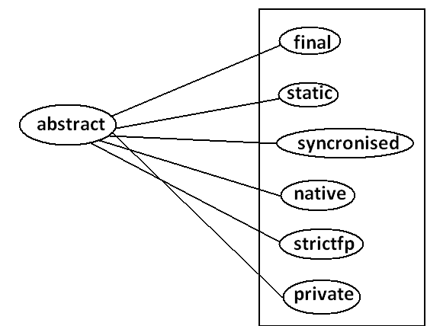
The following are the various illegal combinations for methods.
Diagram:
All the 6 combinations are illegal.
136

Slide 43
Abstract class
134

Slide 44
For any java class if we are not allow to create an object such type of class we have to
declare with abstract modifier that is for abstract class instantiation is not possible
What is the difference between abstract class and abstract method ?
• If a class contain at least on abstract method then compulsory the corresponding
class should be declare with abstract modifier. Because implementation is not
complete and hence we can't create object of that class.
• Even though class doesn't contain any abstract methods still we can declare the
class as abstract that is an abstract class can contain zero no of abstract methods
also.
Example:
abstract class Test
{
public static void main(String args[]){
Test t=new Test();
}}
Output:
Compile time error.
D:\Java>javac Test.java
Test.java:4: Test is abstract; cannot be instantiated
Test t=new Test();
Example1: HttpServlet class is abstract but it doesn't contain any abstract method.
Example2: Every adapter class is abstract but it doesn't contain any abstract method.
136

Slide 45
Example1:
class Parent
{
public void methodOne();
}
Output:
Compile time error.
D:\Java>javac Parent.java
Parent.java:3: missing method body, or declare abstract
public void methodOne();
Example3:
class Parent
{
public abstract void methodOne();
}
Output:
Compile time error.
D:\Java>javac Parent.java
Parent.java:1: Parent is not abstract and does not
override abstract method methodOne() in Parent
class Parent
Example2:
class Parent
{
public abstract void methodOne(){}
}
Output:
Compile time error.
Parent.java:3: abstract methods cannot have a body
public abstract void methodOne(){}
If a class extends any abstract class then compulsory we should provide implementation
for every abstract method of the parent class otherwise we have to declare child class as
abstract.
137

Slide 46
Example:
abstract class Parent
{
public abstract void methodOne();
public abstract void methodTwo();
}
class child extends Parent
{
public void methodOne(){}
}
Output:
Compile time error.
D:\Java>javac Parent.java
Parent.java:6: child is not abstract and does not
override abstract method methodTwo() in Parent
class child extends Parent
What is the difference between final and abstract ?
• For abstract methods compulsory we should override in the child class to
provide implementation. Whereas for final methods we can't override hence
abstract final combination is illegal for methods.
• For abstract classes we should compulsory create child class to provide
implementation whereas for final class we can't create child class. Hence final
abstract combination is illegal for classes.
• Final class cannot contain abstract methods whereas abstract class can contain
final method.
If we declare class child as abstract then the code compiles fine but child of child is
responsible to provide implementation for methodTwo().
137

Slide 47
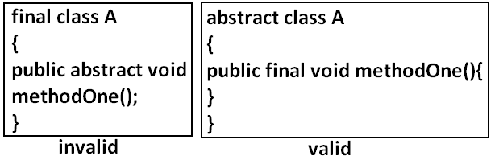
Note:
Usage of abstract methods, abstract classes and interfaces is always good Programming
practice.
138

Slide 48
Strictfp
134

Slide 49
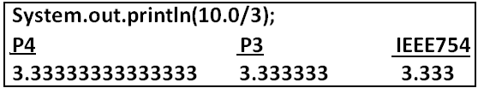
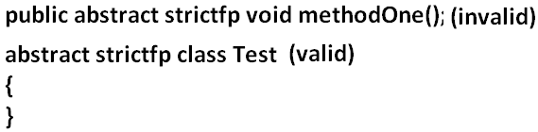
• strictfp is the modifier applicable for methods and classes but not for variables.
• Strictfp modifier introduced in 1.2 versions.
• Usually the result of floating point of arithmetic is varing from platform to
platform , to overcome this problem we should use strictfp modifier.
• If a method declare as the Strictfp then all the floating point calculations in that
method has to follow IEEE754 standard, So that we will get platform
independent results.
What is the difference between abstract and strictfp ?
• Strictfp method talks about implementation where as abstract method never
talks about implementation hence abstract, strictfp combination is illegal for
methods.
• But we can declare a class with abstract and strictfp modifier simultaneously.
That is abstract strictfp combination is legal for classes but illegal for methods
If a class declares as the Strictfp then every concrete method(which has body) of that
class has to follow IEEE754 standard for floating point arithmetic, so we will get
platform independent results.
138

Slide 50
Member modifiers
Public members

Slide 51
If a member declared as the public then we can access that member from anywhere
"but the corresponding class must be visible" hence before checking member visibility
we have to check class visibility.
Program 2:
package pack2;
import pack1.A;
class B
{
public static void main(String args[]){
A a=new A();
a.methodOne();
}}
Output:
Compile time error.
D:\Java>javac -d . B.java
B.java:2: pack1.A is not public in pack1;
cannot be accessed from outside package
import pack1.A;
Example:
Program 1:
package pack1;
class A
{
public void methodOne(){
System.out.println("a class method");
}}
D:\Java>javac -d . A.java
In the above Program even though methodOne() method is public we can't access from
class B because the corresponding class A is not public that is both classes and methods
are public then only we can access.
139

Slide 52
Default member
134

Slide 53
If a member declared as the default then we can access that member only within the
current package hence default member is also known as package level access.
Program 2:
package pack1;
import pack1.A;
class B
{
public static void main(String args[]){
A a=new A();
a.methodOne();
}}
Output:
D:\Java>javac -d . A.java
D:\Java>javac -d . B.java
D:\Java>java pack1.B
methodOne is executed
Example 1:
Program 1:
package pack1;
class A
{
void methodOne(){
System.out.println("methodOne is executed");
}}
140

Slide 54
Example 2:
Program 1:
package pack1;
class A
{
void methodOne(){
System.out.println("methodOne is executed");
}}
Program 2:
package pack2;
import pack1.A;
class B
{
public static void main(String args[]){
A a=new A();
a.methodOne();
}}
Output:
Compile time error.
D:\Java>javac -d . A.java
D:\Java>javac -d . B.java
B.java:2: pack1.A is not public in pack1; cannot be accessed from outside
package
import pack1.A;
141

Slide 55

Private members
If a member declared as the private then we can access that member only with in the current class.Private methods are not visible in child classes where as abstract methods should
be visible in child classes to provide implementation hence private, abstract
combination is illegal for methods.
141

Slide 56

Protected members

Slide 57
• If a member declared as the protected then we can access that member within
the current package anywhere but outside package only in child classes.
Protected=default+kids.
• We can access protected members within the current package anywhere either
by child reference or by parent reference
• But from outside package we can access protected members only in child classes
and should be by child reference only that is we can't use parent reference to call
protected members from outside package.
Program 2:
package pack1;
class B extends A
{
public static void main(String args[]){
A a=new A();
a.methodOne();
B b=new B();
b.methodOne();
A a1=new B();
a1.methodOne();
}}
Output:
D:\Java>javac -d . A.java
D:\Java>javac -d . B.java
D:\Java>java pack1.B
methodOne is executed
methodOne is executed
methodOne is executed
Example:
Program 1:
package pack1;
public class A
{
protected void methodOne(){
System.out.println("methodOne is executed");
}}
141

Slide 58
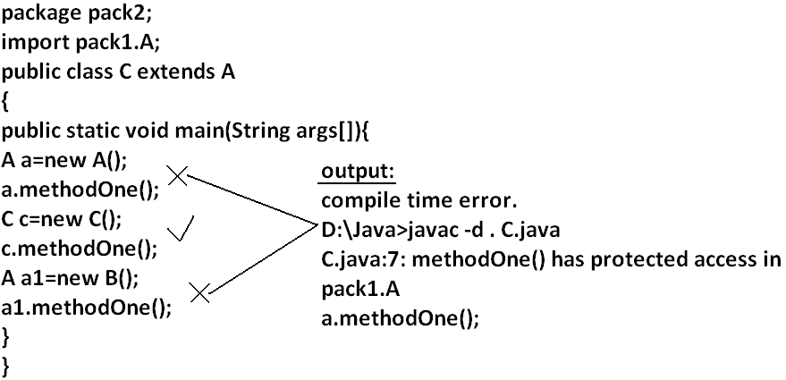
Example 2:
142

Slide 59


Compression of private, default, protected and public
visibility | private | default | protected | public
1)With in the same class
2)From child class of same package
3)From non-child class of same package
4)From child class of outside package |  |  | But we should use Child reference only
5)From non-child class of outside package

Slide 60
• The least accessible modifier is private.
• The most accessible modifier is public.
Private<default<protected<public
Recommended modifier for variables is private where as recommended modifier for methods is public.
143

Slide 61
Final variables
Final instance variables

Slide 62
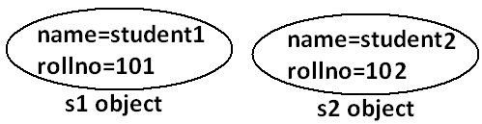
• If the value of a variable is varied from object to object such type of variables are
called instance variables.
• For every object a separate copy of instance variables will be created
Output:
D:\Java>javac Test.java
D:\Java>java Test
0
If the instance variable declared as the final compulsory we should perform
initialization explicitly and JVM won't provide any default values.
whether we are using or not otherwise we will get compile time error.
Example:
Program 1:
class Test
{
int i;
}
Output:
D:\Java>javac Test.java
D:\Java>
For the instance variables it is not required to perform initialization explicitly jvm will always provide default values.
Example:
class Test
{
int i;
public static void main(String args[]){
Test t=new Test();
System.out.println(t.i);
}}
143

Slide 63
Program 2:
class Test
{
final int i;
}
Output:
Compile time error.
D:\Java>javac Test.java
Test.java:1: variable i might not have been initialized
class Test
1) At the time of declaration
Example:
class Test
{
final int i=10;
}
Output:
D:\Java>javac Test.java
D:\Java>
2) Inside instance block:
Rule:
For the final instance variables we should perform initialization before constructor
completion. That is the following are various possible places for this.
Example:
class Test
{
final int i;
{
i=10;
}}
Output:
D:\Java>javac Test.java
D:\Java>
144

Slide 64
3) Inside constructor
Example:
class Test
{
final int i;
Test()
{
i=10;
}}
Output:
D:\Java>javac Test.java
D:\Java>
Example:
class Test
{
final int i;
public void methodOne(){
i=10;
}}
Output:
Compile time error.
D:\Java>javac Test.java
Test.java:5: cannot assign a value to final variable i
i=10;
If we are performing initialization anywhere else we will get compile time error.
145

Slide 65
Final static variables

Slide 66
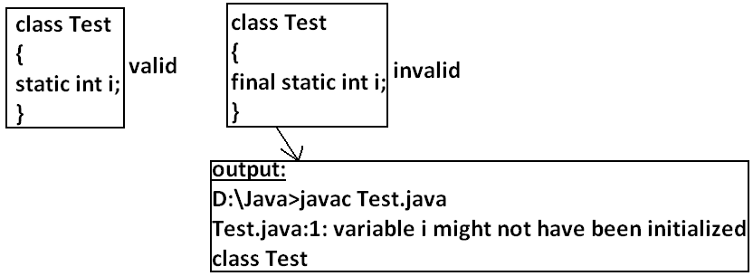
• If the value of a variable is not varied from object to object such type of variables
is not recommended to declare as the instance variables. We have to declare
those variables at class level by using static modifier.
• In the case of instance variables for every object a seperate copy will be created
but in the case of static variables a single copy will be created at class level and
shared by every object of that class.
• For the static variables it is not required to perform initialization explicitly jvm
will always provide default values.
Output:
D:\Java>javac Test.java
D:\Java>java Test
Value of i is: 0
If the static variable declare as final then compulsory we should perform initialization
explicitly whether we are using or not otherwise we will get compile time error.(The JVM won't provide any default values)
Example:
class Test
{
static int i;
public static void main(String args[]){
System.out.println("value of i is :"+i);
}}
145

Slide 67
Rule:
For the final static variables we should perform initialization before class loading completion otherwise we will get compile time error. That is the following are possible places.
static
{
i=10;
}}
Output:
Compile successfully.
1) At the time of declaration
If we are performing initialization anywhere else we will get compile time error
Example:
class Test
{
final static int i=10;
}
Output:
D:\Java>javac Test.java
D:\Java>
Example:
class Test
{
final static int i;
public static void main(String args[]){
i=10;
}}
Output:
Compile time error.
D:\Java>javac Test.java
Test.java:5: cannot assign a value to final variable i
i=10;
2) Inside static block
Example:
class Test
{
final static int i;
146

Slide 68
Final local variables:
• To meet temporary requirement of the Programmer sometime we can declare
the variable inside a method or block or constructor such type of variables are
called local variables.
• For the local variables jvm won't provide any default value compulsory we
should perform initialization explicitly before using that variable.
Example:
class Test
{
public static void main(String args[]){
int i;
System.out.println(i);
}}
Output:
Compile time error.
D:\Java>javac Test.java
Test.java:5: variable i might not have been initialized
System.out.println(i);
Example:
class Test
{
public static void main(String args[]){
int i;
System.out.println("hello");
}}
Output:
D:\Java>javac Test.java
D:\Java>java Test
Hello
Even though local variable declared as the final before using only we should perform initialization.
147

Slide 69
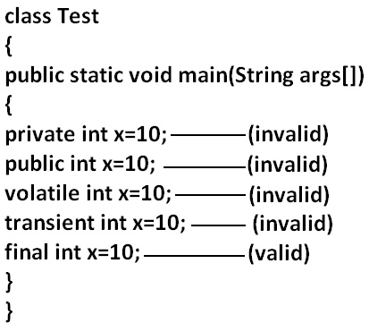
Example:
class Test
{
public static void main(String args[]){
final int i;
System.out.println("hello");
}}
Output:
D:\Java>javac Test.java
D:\Java>java Test
hello
Note: The only applicable modifier for local variables is final if we are using any other
modifier we will get compile time error.
Output:
Compile time error.
D:\Java>javac Test.java
Test.java:5: illegal start of expression
private int x=10;
148

Slide 70
Formal parameters

Slide 71
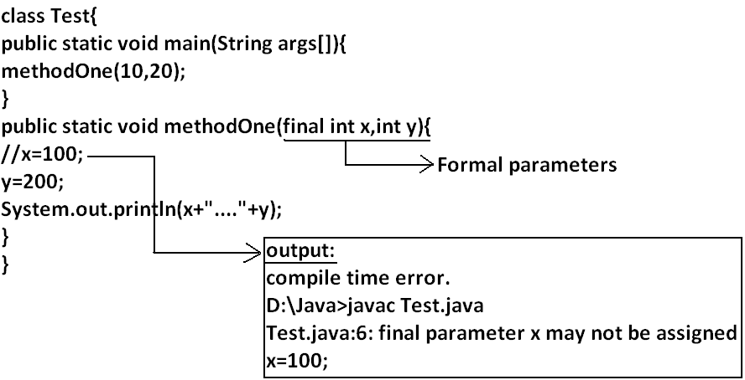
• The formal parameters of a method are simply acts as local variables of that method hence it is possible to declare formal parameters as final.
• If we declare formal parameters as final then we can't change its value within the
method.
• For instance and static variables JVM will provide default values but if instance
and static declared as final JVM won't provide default value compulsory we
should perform initialization whether we are using or not .
• For the local variables JVM won't provide any default values we have to
perform explicitly before using that variables , this rule is same whether local
variable final or not.
149

Slide 72
Static modifier

Slide 73
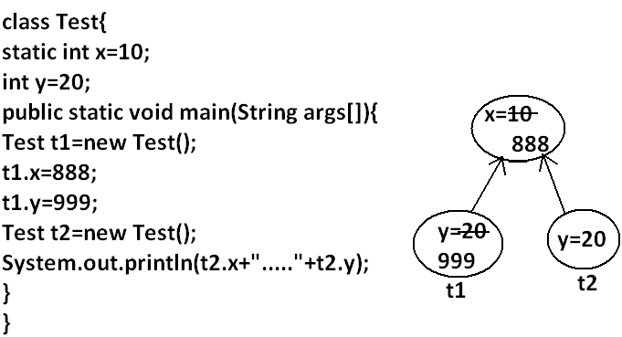
• Static is the modifier applicable for methods, variables and blocks.
• We can't declare a class with static but inner classes can be declaring as the static.
• In the case of instance variables for every object a separate copy will be created but in the case of static variables a single copy will be created at class level and shared by all objects of that class.
Output:
D:\Java>javac Test.java
D:\Java>java Test
888.....20
• Instance variables can be accessed only from instance area directly and we can't access from static area directly.
• But static variables can be accessed from both instance and static areas directly
1) Int x=10;
2) Static int x=10;
3) Public void methodOne(){
System.out.println(x);
}
4) Public static void methodOne(){
System.out.println(x);
}
149

Slide 74
Which are the following declarations are allow within the same class simultaneously ?
a) 1 and 3
Output:
Compile time error.
D:\Java>javac Test.java
Test.java:5: non-static variable x cannot be referenced from a static
context
System.out.println(x);
c) 2 and 3
Example:
class Test
{
int x=10;
public void methodOne(){
System.out.println(x);
}}
Output:
Compile successfully
Example:
class Test
{
static int x=10;
public void methodOne(){
System.out.println(x);
}}
Output:
Compile successfully.
d) 2 and 4
b) 1 and 4
Example:
class Test
{
int x=10;
public static void methodOne(){
System.out.println(x);
}}
151

Slide 75
Example:
class Test{
public void methodOne(){
System.out.println(x);
}
public static void methodOne(){
System.out.println(x);
}}
Output:
Compile time error.
D:\Java>javac Test.java
Test.java:5: methodOne() is already defined in Test
public static void methodOne(){
Example:
class Test
{
static int x=10;
public static void methodOne(){
System.out.println(x);
}}
Output:
Compile successfully.
e) 1 and 2
Example:
class Test
{
int x=10;
static int x=10;
}
Output:
Compile time error.
D:\Java>javac Test.java
Test.java:4: x is already defined in Test
static int x=10;
f) 3 and 4
For static methods implementation should be available but for abstract methods
implementation is not available hence static abstract combination is illegal for methods
151

Slide 76
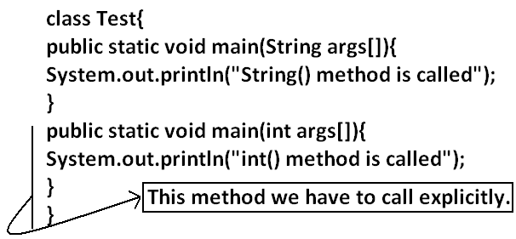
case 1
case 2:
Overloading concept is applicable for static method including main method also.But JVM will always call String[] args main method .The other overloaded method we have to call explicitly then it will be executed just like
a normal method call .
Inheritance concept is applicable for static methods including main() method hence while executing child class, if the child doesn't contain
main()method then the parent class main method will be executed.
Example:
class Parent{
public static void main(String args[]){
System.out.println("parent main() method called");
}
}
class child extends Parent{
}
Output :
String() method is called
152

Slide 77
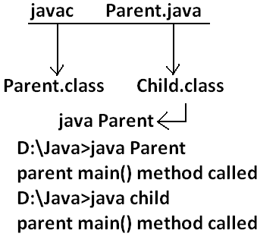
Output
• It seems to be overriding concept is applicable for static methods but it is not
overriding it is method hiding.
154

Slide 78
Native modifier:

Slide 79
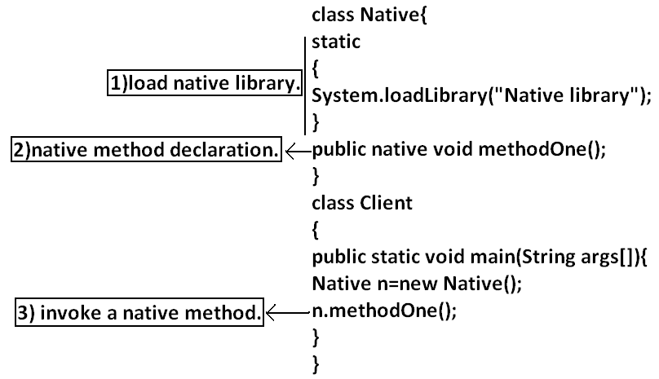
• Native is a modifier applicable only for methods but not for variables and classes.
• The methods which are implemented in non java are called native methods or foreign methods.
The main objectives of native keyword are:
• To improve performance of the system.
• To use already existing legacy non-java code.
• To achieve machine level communication(memory level - address)
• Pseudo code to use native keyword in java.
To use native keyword
Pseudo code
155

Slide 80
• For native methods implementation is already available and we are not
responsible to provide implementation hence native method declaration should
compulsory ends with semicolon.
o Public native void methodOne()----invalid
o Public native void methodOne();---valid
• For native methods implementation is already available where as for abstract
methods implementation should not be available child class is responsible to
provide that, hence abstract native combination is illegal for methods.
• We can't declare a native method as strictfp because there is no guaranty
whether the old language supports IEEE754 standard or not. That is native
strictfp combination is illegal for methods.
• For native methods inheritance, overriding and overloading concepts are
applicable.
• The main advantage of native keyword is performence will be improves.
• The main disadvantage of native keyword is usage of native keyword in java
breaks platform independent nature of java language.
156

Slide 81
Synchronized
1. Synchronized is the modifier applicable for methods and blocks but not for
variables and classes.
2. If a method or block declared with synchronized keyword then at a time only one
thread is allow to execute that method or block on the given object.
3. The main advantage of synchronized keyword is we can resolve data
inconsistency problems.
4. But the main disadvantage is it increases waiting time of the threads and effects
performance of the system. Hence if there is no specific requirement never
recommended to use synchronized keyword.
For syncronized methods compulsory implementation should be available , but for
abstract methods implementation won't be available , Hence abstract - syncronized
combination is illegal for methods

Slide 82
Synchronized
1. Synchronized is the modifier applicable for methods and blocks but not for
variables and classes.
2. If a method or block declared with synchronized keyword then at a time only one
thread is allow to execute that method or block on the given object.
3. The main advantage of synchronized keyword is we can resolve data
inconsistency problems.
4. But the main disadvantage is it increases waiting time of the threads and effects
performance of the system. Hence if there is no specific requirement never
recommended to use synchronized keyword.
For syncronized methods compulsory implementation should be available , but for
abstract methods implementation won't be available , Hence abstract - syncronized
combination is illegal for methods

Slide 83
Transient modifier
1. Transient is the modifier applicable only for variables but not for methods and
classes.
2. At the time of serialization if we don't want to serialize the value of a particular
variable to meet the security constraints then we should declare that variable
with transient modifier.
3. At the time of serialization jvm ignores the original value of the transient
variable and save default value that is transient means "not to serialize".
4. Static variables are not part of object state hence serialization concept is not
applicable for static variables duo to this declaring a static variable as transient
there is no use.
5. Final variables will be participated into serialization directly by their values due
to this declaring a final variable as transient there is no impact.
156

Slide 84
Volatile modifier
1. Volatile is the modifier applicable only for variables but not for classes and
methods.
2. If the value of variable keeps on changing such type of variables we have to
declare with volatile modifier.
3. If a variable declared as volatile then for every thread a separate local copy will
be created by the jvm, all intermediate modifications performed by the thread
will takes place in the local copy instead of master copy.
4. Once the value got finalized before terminating the thread that final value will be
updated in master copy.
5. The main advantage of volatile modifier is we can resolve data inconsistency
problems, but creating and maintaining a separate copy for every thread
increases complexity of the Programming and effects performance of the system.
Hence if there is no specific requirement never recommended to use volatile
modifier and it's almost outdated.
6. Volatile means the value keep on changing where as final means the value never
changes hence final volatile combination is illegal for variables.
157

Slide 85
Summary of modifier

Slide 86
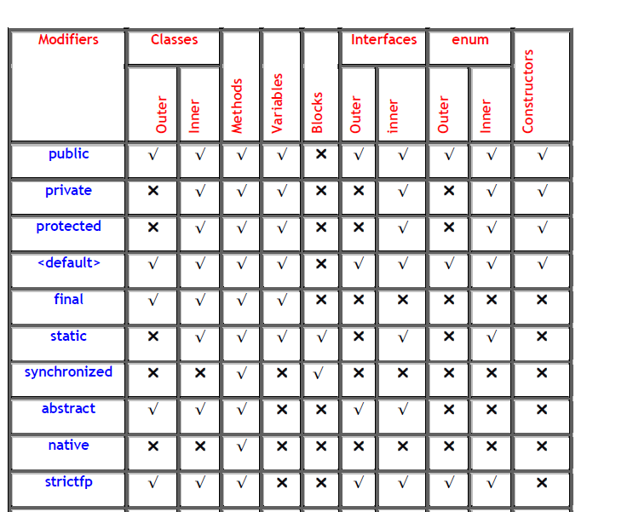
158

Slide 87
Conclusions:
• The Only Applicable Modifiers for Constructors are public, private, protected, and
<default>.
• The Only Applicable Modifiers for Local Variable is final.
• The Only Modifier which is applicable for Classes but Not for Interfaces is final.
• The Modifiers which are Applicable for Classes but Not for enum are final and
abstract.
• The Modifiers which are Applicable for Inner Classes but Not for Outer Classes are
public, protected, and static.
• The Only Modifier which is Applicable for Methods is native.
• The Modifiers which are Applicable for Variables are transient and volatile.
158

Slide 88
12) Whenever we are extending abstract Class is it Compulsory required to Provide
Implementation for Every abstract Method of that Class?
13) Is final Class can contain abstract Method?
14) Is abstract Class can contain final Methods?
15) Can You give Example for abstract Class which doesn’t contain any abstract
Method?
16) Which of the following Modifiers Combinations are Legal for Methods?
▪ public – static
▪ static – abstract
▪ abstract - final
▪ final - synchronized
▪ synchronized - native
▪ native – abstract
17) Which of the following Modifiers Combinations are Legal for Classes?
▪ public - final
▪ final - abstract
▪ abstract - strictfp
▪ strictfp – public
18) What is the Difference between abstract Class and Interface?
Java Modifiers Important Questions
1) For the Top Level Classes which Modifiers are Allowed?
2) Is it Possible to Declare a Class as static, private, and protected?
3) What are Extra Modifiers Applicable for Inner Classes when compared with Outer
Classes?
4) What is a final Class?
5) Explain the Differences between final, finally and finalize?
6) Is Every Method Present in final Class is final?
7) Is Every Variable Present Inside a final Class is final?
8) What is abstract Class?
9) What is abstract Method?
10) If a Class contain at least One abstract Method is it required to declared that Class
Compulsory abstract?
11) If a Class doesn’t contain any abstract Methods is it Possible to Declare that Class as
abstract?
159

Slide 89
19) What is strictfp Modifier?
20) Is it Possible to Declare a Variable with strictfp?
21) abstract - strictfp Combination, is Legal for Classes OR Methods?
22) Is it Possible to Override a native Method?
23) What is the Difference between Instance and Static Variable?
24) What is the Difference between General Static Variable and final Static Variable?
25) Which Modifiers are Applicable for Local Variable?
26) When the Static Variables will be Created?
27) What are Various Memory Locations of Instance Variables, Local Variables and Static Variables?
28) Is it Possible to Overload a main()?
29) Is it Possible to Override Static Methods?
30) What is native Key Word and where it is Applicable?
31) What is the Main Advantage of the native Key Word?
32) If we are using native Modifier how we can Maintain Platform Independent Nature?
33) How we can Declare a native Method?
34) Is abstract Method can contain Body?
35) What is synchronized Key Word where we can Apply?
36) What are Advantages and Disadvantages of synchronized Key Word?
37) Which Modifiers are the Most Dangerous in Java?
38) What is Serialization and Explain how its Process?
39) What is Deserialization?
40) By using which Classes we can Achieve Serialization and Deserialization?
41) What is Serializable interface and Explain its Methods?
42) What is a Marker Interface and give an Example?
43) Without having any Method in Serializable Interface, how we can get Serializable
Ability for Our Object?
44) What is the Purpose of transient Key Word and Explain its Advantages?
160

Slide 90
45) Is it Possible to Serialize Every Java Object?
46) Is it Possible to Declare a Method, a Class with transient?
47) If we Declare Static Variable with transient is there any Impact?
48) What is the Impact of declaring final Variable a transient?
49) What is volatile Variable?
50) Is it Possible to Declare a Class OR a Method with volatile?
51) What is the Advantage and Disadvantage of volatile Modifier?
3. The modifiers which are applicable only for variables transient and volatile.
4. The modifiers which are applicable for constructor public, private, protected,
default.
5. The only applicable modifier for local variables is final.
6. The modifiers which are applicable for classes but not for enums are final ,
abstract.
7. The modifiers which are applicable for classes but not for interface are final.
Note :
1. The modifiers which are applicable for inner classes but not for outer classes are
private, protected, static.
2. The modifiers which are applicable only for methods native.
161

Slide 91
Interfaces

Slide 92
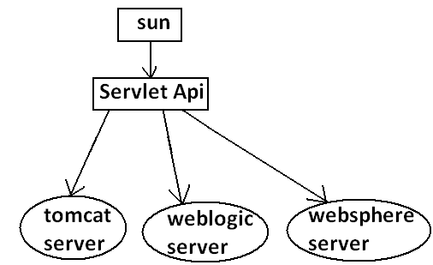
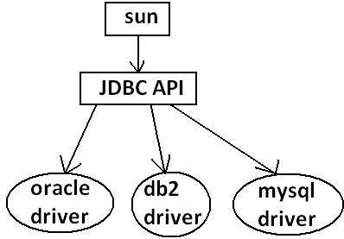
Def1: Any service requirement specification (srs) is called an interface.
Example1: Sun people responsible to define JDBC API and database vendor will
provide implementation for that.
Example2: Sun people define Servlet API to develop web applications web server
vendor is responsible to provide implementation.
162

Slide 93
Def2: From the client point of view an interface define the set of services what is
expecting. From the service provider point of view an interface defines the set of
services what is offering. Hence an interface is considered as a contract between client
and service provider.
Example: ATM GUI screen describes the set of services what bank people offering, at
the same time the same GUI screen the set of services what customer is expecting hence
this GUI screen acts as a contract between bank and customer.
Def3: Inside interface every method is always abstract whether we are declaring or not
hence interface is considered as 100% pure abstract class.
Summery def: Any service requirement specification (SRS) or any contract between
client and service provider or 100% pure abstract classes is considered as an interface
163

Slide 94
Declaration and implementation of an interface

Slide 95
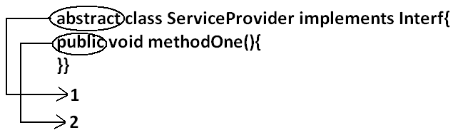
Note1:
Whenever we are implementing an interface, compulsory for every method of that
Interface, we should provide implementation otherwise we have to declare class as
Abstract. In that case child class is responsible to provide implementation for remaining
methods.
Note2:
Whenever we are implementing an interface method it should be declared as ‘public’, otherwise we will get compile time error.
class SubServiceProvider extends ServiceProvider
{
}
Output:
Compile time error.
D:\Java>javac SubServiceProvider.java
SubServiceProvider.java:1:
SubServiceProvider is not abstract and does not override
abstract method methodTwo() in Interf
class SubServiceProvider extends ServiceProvider
Example:
interface Interf
{
void methodOne();
void methodTwo();
}
163

Slide 96
Extends vs implements

Slide 97
class Three implements One,Two{
public void methodOne(){
}
public void methodTwo(){
}
}
A class can extends only one class at a time
Example:
class One{
public void methodOne(){
}
}
class Two extends One{
}
A class can implements any no. Of interfaces at a time.
A class can extend a class and can implement any no. Of interfaces simultaneously
interface One{
void methodOne();
}
class Two
{
public void methodTwo(){
}
}
class Three extends Two implements One{
public void methodOne(){
}
}
Example:
interface One{
public void methodOne();
}
interface Two{
public void methodTwo();
}
An interface can extend any no. Of interfaces at a time
164

Slide 98
Example:
interface One{
void methodOne();
}
interface Two{
void methodTwo();
}
interface Three extends One,Two
{
}
Ans: 6
Consider the expression X extends Y for which of the possibility of X and Y this
expression is true?
1. Both x and y should be classes.
2. Both x and y should be interfaces.
3. Both x and y can be classes or can be interfaces.
4. No restriction.
Ans: 3
X extends Y, Z ?
X, Y, Z should be interfaces.
X extends Y implements Z ?
X, Y should be classes.
Z should be interface.
X implements Y, Z ?
X should be class.
Y, Z should be interfaces.
X implements Y extend Z ?
Which of the following is true?
1. A class can extend any no.Of classes at a time.
2. An interface can extend only one interface at a time.
3. A class can implement only one interface at a time.
4. A class can extend a class and can implement an interface but not both
simultaneously.
5. An interface can implement any no.Of interfaces at a time.
6. None of the above.
165

Slide 99
Example:
interface One{
}
class Two {
}
class Three implements One extends Two{
}
Output:
Compile time error.
D:\Java>javac Three.java
Three.java:5: '{' expected
class Three implements One extends Two{
165

Slide 100
Interface methods

Slide 101
Every method present inside interface is always public and abstract whether we are
declaring or not. Hence inside interface the following method declarations are equal
Inside interfacewhich method declarations are valid?
1. public void methodOne(){}
2. private void methodOne();
3. public final void methodOne();
4. public static void methodOne();
5. public abstract void methodOne();
Ans: 5
void methodOne();
public void methodOne();
abstract void methodOne(); Equal
public abstract void methodOne();
public: To make this method available for every implementation class.
abstract: Implementation class is responsible to provide implementation
166
As every interface method is always public and abstract we can't use the following
modifiers for interface methods.
Private, protected, final, static, synchronized, native, strictfp.
166

Slide 102
Interface variables

Slide 103
• An interface can contain variables
• The main purpose of interface variables is to define requirement level constants.
• Every interface variable is always public static and final whether we are
declaring or not.
int x=10;
public int x=10;
static int x=10;
final int x=10; Equal
public static int x=10;
public final int x=10;
static final int x=10;
public static final int x=10;
Example:
interface interf
{
int x=10;
}
• As every interface variable by default public static final we can't declare with the
following modifiers.
o Private
o Protected
o Transient
o Volatile
• For the interface variables compulsory we should perform initialization at the
time of declaration only otherwise we will get compile time error.
public: To make it available for every implementation class.
static: Without existing object also we have to access this variable.
final: Implementation class can access this value but cannot modify.
Hence inside interface the following declarations are equal
166

Slide 104
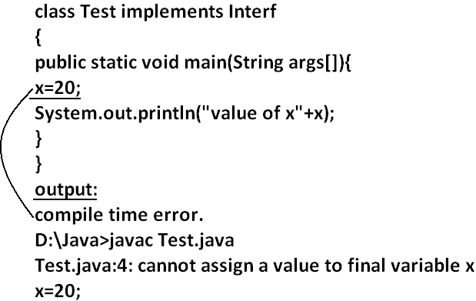
Example:
interface Interf
{
int x=10;
}
Example:
interface Interf
{
int x;
}
Output:
Compile time error.
D:\Java>javac Interf.java
Interf.java:3: = expected
int x;
Which of the following declarations are valid inside interface ?
1. int x;
2. private int x=10;
3. public volatile int x=10;
4. public transient int x=10;
5. public static final int x=10;
Ans: 5
Interface variables can be access from implementation class but cannot be modified.
167

Slide 105
Example 2:
class Test implements Interf
{
public static void main(String args[]){
int x=20;
//here we declaring the variable x.
System.out.println(x);
}
}
Output:
D:\Java>javac Test.java
D:\Java>java Test
20\
168

Slide 106
Interface naming conflicts
Method naming conflicts

Slide 107
Example 3:
class Test implements Left,Right
{
public void methodOne()
{
}}
Output:
D:\Java>javac Left.java
D:\Java>javac Right.java
D:\Java>javac Test.java
Case 1:
If two interfaces contain a method with same signature and same return type in the
implementation class only one method implementation is enough.
Example 1:
interface Left
{
public void methodOne();
}
Example 2:
interface Right
{
public void methodOne();
}
Case 2:
if two interfaces contain a method with same name but different arguments in the
implementation class we have to provide implementation for both methods and these
methods acts as a overloaded methods
168

Slide 108
Example 1:
interface Left
{
public void methodOne();
}
Example 2:
interface Right
{
public void methodOne(int i);
}
Output:
D:\Java>javac Left.java
D:\Java>javac Right.java
D:\Java>javac Test.java
Example 3:
class Test implements Left,Right
{
public void methodOne()
{
}
public void methodOne(int i)
{
}}
Output:
D:\Java>javac Left.java
D:\Java>javac Right.java
D:\Java>javac Test.java
Example 3:
class Test implements Left,Right
{
public void methodOne()
{
}
public void methodOne(int i)
{
}}
169

Slide 109
Case 3:
If two interfaces contain a method with same signature but different return types then it
is not possible to implement both interfaces simultaneously.
We can't write any java class that implements both interfaces simultaneously.
Is a java class can implement any no. Of interfaces simultaneously ?
Yes, except if two interfaces contains a method with same signature but different return types.
Example 1:
interface Left
{
public void methodOne();
}
Example 2:
interface Right
{
public int methodOne(int i);
}
169

Slide 110
Variable naming conflicts
Example 3:
class Test implements Left,Right
{
public static void main(String args[]){
//System.out.println(x);
System.out.println(Left.x);
System.out.println(Right.x);
}
}
Output:
D:\Java>javac Left.java
D:\Java>javac Right.java
D:\Java>javac Test.java
D:\Java>java Test
888
999
Two interfaces can contain a variable with the same name and there may be a chance
variable naming conflicts but we can resolve variable naming conflicts by using interface names
Example 1:
interface Left
{
int x=888;
}
Example 2:
interface Right
{
int x=999;
}
170

Slide 111
Marker interface
Example 2:
By implementing SingleThreadModel interface Servlet can process only one client request at a time so that we can get "Thread Safety"
If an interface doesn't contain any methods and by implementing that interface if our objects will get some ability such type of interfaces are called Marker interface (or) Tag interface (or) Ability interface.
Example 3:
By implementing Cloneable interface our object is in a position to provide exactly
duplicate cloned object.
Example:
Serializable
Cloneable
RandomAccess These are marked for some ability
SingleThreadModel
.
.
.
.
Without having any methods in marker interface how objects will get ability ?
Internally JVM is responsible to provide required ability.
Why JVM is providing the required ability in marker interfaces ?
To reduce complexity of the programming.
Is it possible to create our own marker interface ?
Yes, but customization of JVM must be required.
Ex : Sleepable , Jumpable , ....
Example 1:
By implementing Serilaizable interface we can send that object across the network and we can save state of an object into a file.
171

Slide 112
Adapter class

Slide 113
• Adapter class is a simple java class that implements an interface only with empty
implementation for every method.
• If we implement an interface directly for each and every method compulsory we
should provide implementation whether it is required or not. This approach
increases length of the code and reduces readability
Example 2:
class Test implements X{
public void m3(){
System.out.println("m3() method is called");
}
public void m1(){}
public void m2(){}
public void m4(){}
public void m5(){}
}
Example 1:
interface X{
void m1();
void m2();
void m3();
void m4();
//.
//.
//.
//.
void m5();
}
• We can resolve this problem by using adapter class.
• Instead of implementing an interface if we can extend adapter class we have to
provide implementation only for required methods but not for all methods of
that interface.
• This approach decreases length of the code and improves readability.
171

Slide 114
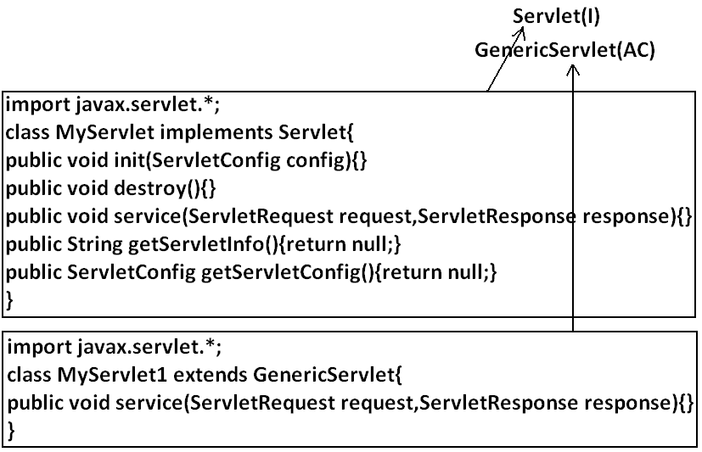
Example 1:
abstract class AdapterX implements X{
public void m1(){}
public void m2(){}
public void m3(){}
public void m4(){}
//.
//.
//.
public void m1000(){}
}
Example 2:
public class Test extend AdapterX{{
public void m3(){
}}
Generic Servlet simply acts as an adapter class for Servlet interface.
Note : marker interface and Adapter class are big utilities to the programmer to
simplify programming
172

Slide 115
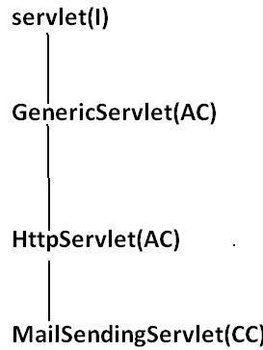
What is the difference between interface, abstract class and concrete class?
When we should go for interface, abstract class and concrete class?
• If we don't know anything about implementation just we have requirement
specification then we should go for interface.
• If we are talking about implementation but not completely (partial
implementation) then we should go for abstract class.
• If we are talking about implementation completely and ready to provide service
then we should go for concrete class.
173

Slide 116
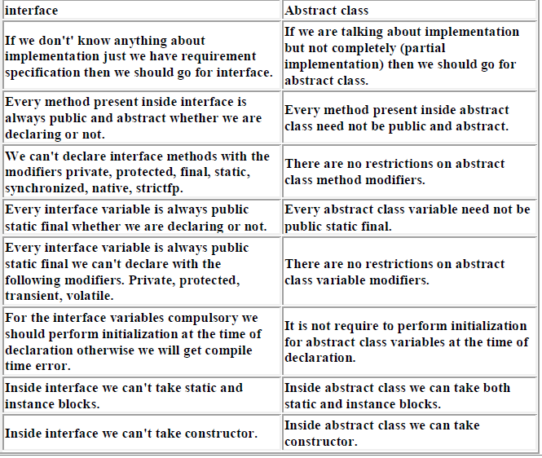
What is the Difference between interface and abstract class ?
174

Slide 117
We can't create object for abstract class but abstract class can contain constructor what is the need ?
abstract class constructor will be executed when ever we are creating child class object to perform initialization of child object.
Example:
class Parent{
Parent()
{
System.out.println(this.hashCode());
}
}
class child extends Parent{
child(){
System.out.println(this.hashCode());
}
}
class Test{
public static void main(String args[]){
child c=new child();
System.out.println(c.hashCode());
}
}
Note : We can't create object for abstract class either directly or indirectly
174

Slide 118
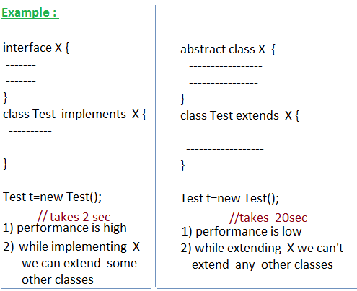
Every method present inside interface is abstract but in abstract class also we can take only abstract methods then what is the need of interface concept ?
We can replace interface concept with abstract class. But it is not a good programming practice. We are misusing the roll of abstract class. It may create performence problems also. (this is just like recruiting IAS officer for sweeping purpose)
If every thing is abstract then it is recommended to go for interafce.
175

Slide 119
Why abstract class can contain constructor where as interface doesn't contain constructor ?
6) Explain about Interface Methods and what Modifiers are Applicable for them?
7) Can Java Class implement any Number of Interfaces?
8) If 2 Interfaces contains a Method with Same Signature but different Return Types,
then how we can implement Both Interfaces Simultaneously?
9) Difference between extends and implements Key Word?
10) We cannot Create an Object of Abstract Class then what is Necessity of having
Constructor Inside Abstract Class?
11) What is a Marker Interface? Give an Example?
12) What is Adapter Class and Explain its Usage?
13) An Interface contains only Abstract Methods and an Abstract Class also can contain
only Abstract Methods then what is the Necessity of Interface?
14) In Your Previous Project where You used the following Marker Interface, Abstract
Class, Interface and Adapter Class?
The main purpose of constructor is to perform initialization of an object i.e., provide
values for the instance variables, Inside interface every variable is always static and
there is no chance of existing instance variables. Hence constructor is not required for
interface.
But abstract class can contains instance variable which are required for the child object
to perform initialization for those instance variables constructor is required in the case
of abstract class.
Interfaces Important Questions
1) What is Interface?
2) What is Difference between Interface and Abstract Class?
3) When we should Go for Interface and Abstract Class and Concrete Class?
4) What Modifiers Applicable for Interfaces?
5) Explain about Interface Variables and what Modifiers are Applicable for them?
175

Slide 120
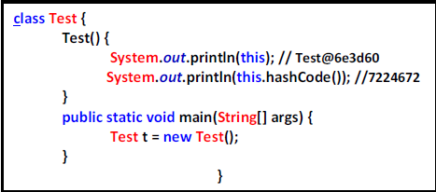
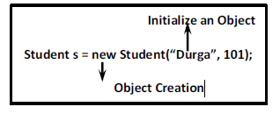
The Purpose of Constructor is
• To Initialize an Object but Not to Create an Object.
• Whenever we are creating an Object after Object Creation automatically
Constructor will be executed to Initialize that Object.
• Object Creation by New Operator and then Initialization by Constructor
• Before Constructor Only Object is Ready and Hence within the Constructor we can Access Object Properties Like Hash Code.
• Whenever we are creating Child Class Object automatically Parent Constructor will
be executed but Parent Object won’t be created.
• The Purpose of Parent Constructor Execution is to Initialize Child Object Only. Of
Course for the Instance Variables which are inheriting from parent Class.
177

Slide 121
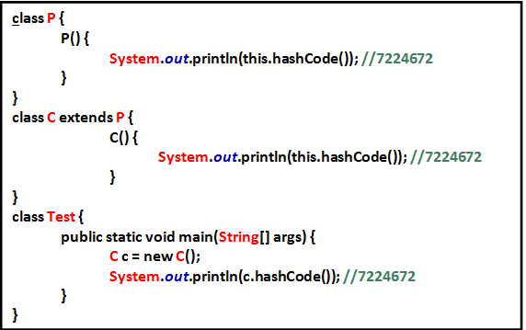
• In the Above Example whenever we are creating Child Object Both Parent and
Child Constructors will be executed for Child Object Purpose Only.
• In the Above Example we are Just creating Student Object but Both Person and
Student Constructor to Initialize Student Object Only.

Slide 122
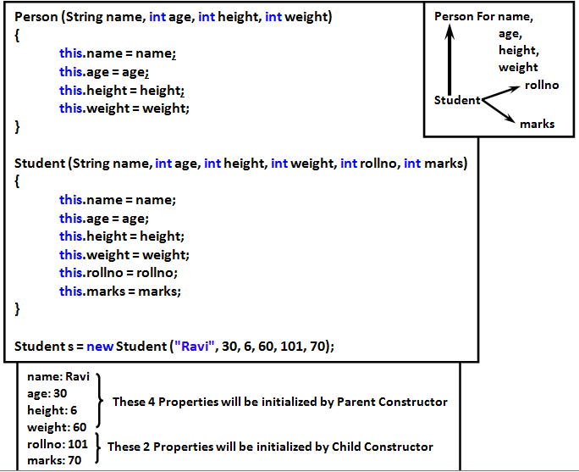

Slide 123
• Whenever we are creating an Object automatically Constructor will be executed
but it May be One Constructor OR Multiple Constructors.
• Either Directly OR Indirectly we can’t Create Object for Abstract Class but Abstract
Class can contain Constructor what is the Need.
• Whenever we are creating Child Object Automatically Abstract Class Constructor
will be executed to Perform Initialization of Child Object for the Properties
whether inheriting from Abstract Class (Code Reusability)
Without abstract Class Constructor
class Student extends Person {
int rollno;
int marks;
Student(String name, int age, int height, int weight) {
this.name = name;
this.age = age;
this.height = height;
this.weight = weight;
this.rollno = rollno;
this.marks = marks;
}
}
Student s = new String("Durga", 30, 6, 60, 101, 70);
178

Slide 124
abstract class Person {
String name;
int age, height, weight;
}
class Teache extends Person {
String subject;
double salary;
}
Teacher(String name, int age, int height, int weight, String subject, double salary) {
this.name = name;
this.age = age;
this.height = height;
this.weight = weight;
this.rollno = rollno;
this.marks = marks;
this.subject = subject;
this.salary = salary;
}
Teacher t = new Teacher("Ravi", 50, 6, 70, "Java", 50K);
179

Slide 125
class Student extends Person {
int rollno, marks;
Student(String name, int age, int height, int weight, int rollno, int marks) {
super(name, age, height, weight);
this.rollno = rollno;
this.marks = marks;
}
}
With abstract Class Constructor
abstract class Person {
String name;
int age;
int height;
int weight;
public Person(String name, int age, int height, int weight) {
super();
this.name = name;
this.age = age;
this.height = height;
this.weight = weight;
}
}
class Teacher extends Person {
String sub;
double salary;
Teacher(String name, int age, int height, int weight, String sub, double salary) {
super(name, age, height, weight);
this.sub = sub;
this.salary = salary;
}
}
180

Slide 126
Any Way we can’t Create Object for Abstract Class and Interface. But Abstract Class can contain Constructor but Interface doesn’t Why?
• The Main Purpose of Constructor is to Perform Initialization of an Object i.e. to
Provide Values for Instance Variables.
• Abstract Class can contain Instance Variables which are required for Child Class
Object to Perform Initialization of these Instance Variables Constructor is required
Inside Abstract Class.
• But Every Variable Present Inside Interface is Always public, static and final
whether we are declaring OR Not and Every Interface Variable we should Perform
Initialization at the Time of Declaration and Hence Inside Interface there is No
Chance of existing Instance Variable.
• Due to this Initialization of Instance Variables Concept Not Applicable for
Interfaces.
• Hence Constructor Concept Not required for Interface.
abstract class Person {
String name;
int age;
Person(String name, int age) {
this.name = name;
this.age = age; → Current Child Class Object
}
}
180

Slide 127
Inside Interface we can take Only Abstract Methods. But in Abstract Class Also we can take Only Abstract Methods Based on Our Requirement. Then what is the Need of Interface? i.e. Is it Possible to Replace Interface Concept with Abstract Class?
• While extending X we can’t extend any Other Class.
• While implementing Interface we can extend any Other Class and Hence we won’t
Miss any Inheritance Benefit.
We can Replace Interface with Abstract Class but it is Not Good Programming Practice
(This is Like requesting IAS Officer for sweeping Activity)
• In the Case ❶ Object Creation is Costly.
Test t = new Test(); → 2 Mins
• In the Case ❷ Object Creation is Not Costly.
Test t = new Test(); → 2 Sec
abstract class X
{
---------------
---------------
}
class Test extends X {}
interface X
{
---------------
---------------
}
class Test implements X {}
• Hence if everything is Abstract Highly Recommended to Use Interface but Not
Abstract Class.
• If we are talking About Implementation of Course Partial Implementation then Only
we should go for Abstract Class.
181

Slide 128
Which of the following are Valid?
1) The Purpose of Constructor is to Create an Object. 
2) The Purpose of Constructor is to Initialize an Object but Not to Create Object. √
3) Once Constructor completes then Only Object Creation completes. 
4) First Object will be Created and then Constructor will be executed. √
5) The Purpose of new Key Word is to Create Object and the Purpose of
Constructor is to Initialize that Object. √
6) We can’t Create Object for Abstract Class Directly but Indirectly we can Create.
√
7) Whenever we are creating Child Class Object Automatically Parent Class Object
will be created Internally. 
8) Whenever we are creating Child Class Object Automatically Abstract Class
Constructor will be executed. √
9) Whenever we are creating Child Class Object Automatically Parent Object will
be Created. 
10) Whenever we are creating Child Class Object Automatically Parent Constructor
will be executed but Parent Object won’t be Created. √
11) Either Directly OR Indirectly we can’t Create Object for Abstract Class and
Hence Constructor Concept is Not Applicable for Abstract Class. 
12) Interface can contain Constructor. 
182

Slide 129
Resources
Thank you

